Slide 1
Truth Commissions: Systemic Injustices
gender class language caste race religion region ethnicity sexual-identity nationality gender class language caste race religion region ethnicity sex
Vasuki Nesiah

Slide 2
Truth Commissions: Windows of Opportunity to Address Gendered HR
They can highlight neglected abuses
They can connect the dots in ways that gives us a big picture perspective into the gendered dimensions of human rights history
They can research the enabling conditions of gendered violations
They can provide a forum for victims and survivors - shaping national history from multiple perspectives
They can stage a new approach to gender equality in citizenship – the valuing of all lives, all experiences
They can recommend reparations and justice measures that redress injustices and the work of the truth commission can build political will to that end
They can leave a long-term legacy in transforming moments of transition into moments of social change

Slide 3
I. History of Transitional Justice and Gender: Coming to Terms with the Past
  A. Phase I
  B. Phase II
  C. Phase III
II. Debates in Transitional Justice and Gender
  A. Enduring Criticisms of Gendered Bias
  B. Responses to Gendered Bias
  C. Questions re. Responses to Gendered Bias
III. Opportunities
  A. Truth Commissions: Windows of Opportunity to Address Gendered HR
    Ex. Strategies Adopted viz. Reparation Programs.
  B. Critically Reflective Gender Analysis: Windows of Opportunity for Truth Commissions

Slide 4
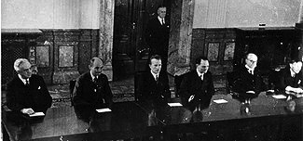
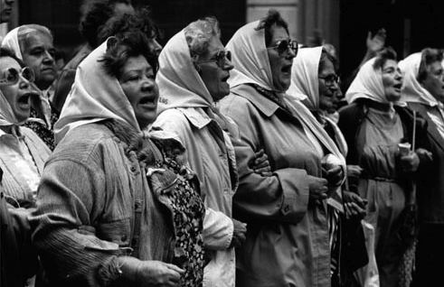
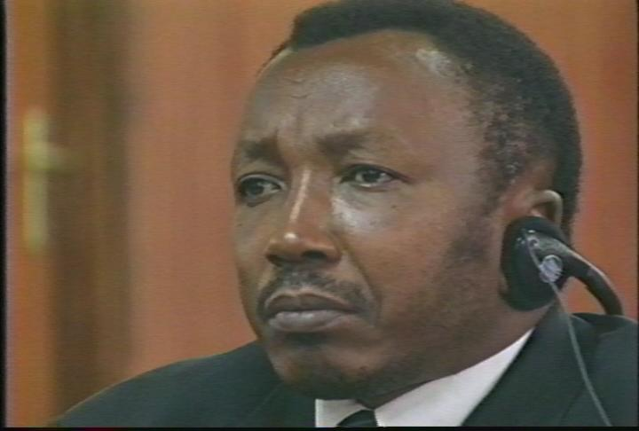
I. Transitional Justice and Gender: Coming to Terms with the Past
Phase I: Outside the frame
Period Extending from the establishment of the International Military Tribunal @ Nuremberg (1945) to National Commission on the Disappeared (CONADEP) in Argentina (established 1983)
Windows:
  Mothers of the Disappeared in Argentina
  Comfort Women in South East Asia
Phase II: Invisibility to Sexing the Body Politic
Period Extending from the establishment of the National Commission for Truth and Reconciliation in Chile (1990) to the Rome Statute for the International Criminal Court (1998 –came into effect, 2002)
Windows:
  Guatemalan Commission for Historical Clarification
  South African Truth and Reconciliation Commission
  ICTY: The Prosecutor vs.. Du{ko Tadi)
  ICTR: The Prosecutor vs.. Jean Paul Akayesu
  Rome Statute for the International Criminal
  Court (Substantive jurisdiction, procedures & structure)
Notes:
Phase I: Before the 1990s, sexual violence in war was, with rare exception, largely invisible. If not invisible, it was trivialized; if not trivialized, it was considered a private matter or justified as an inevitable by-product of war, the necessary reward for the fighting men.”—Rhonda Copelon, “Gender Crimes As War Crimes: Integrating Crimes Against Women Into International Criminal Law,” McGill Law Journal, November 2000
Phase II: Guatemal – rape as an isntrument of genocide; SA – 3 women’s hearings, “ideas of model men or model women” emasculating Black men as a mode of attack

Slide 5
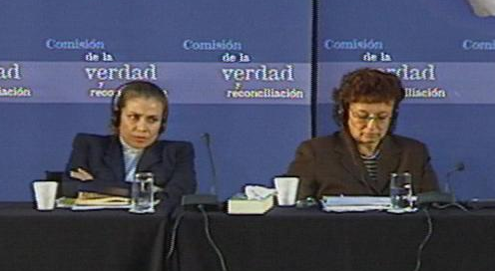
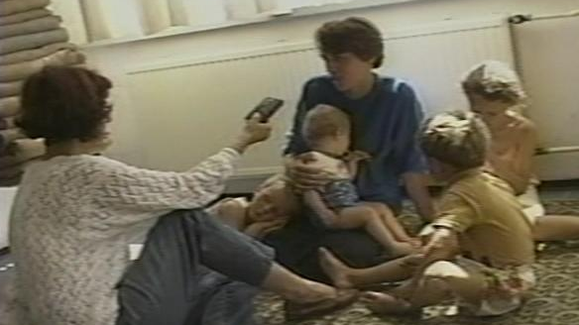
Transitional Justice and Gender: Coming to Terms with the Past (cont.)
Phase III: Some achievements, Some failures, Many fault lines
Period Extending from the establishment of the Special Court
for Sierra Leone (2000) to the present
Windows:
  Peruvian Truth and Reconciliation Commission
  (Comisión de la Verdad y Reconciliación, CVR)
  Commission for Reception, Truth, and Reconciliation (CAVR) established in Timor Leste (2002)
  Truth and Reconciliation Commission (TRC) established in Sierra Leone (2002)
  Truth and Reconciliation Commission in Ghana
  Moroccan Equity and Reconciliation Commission
  (Instance Equité et Réconciliation, IER; 2004)
  Security Council Resolution 1325
  “Transition” in Afghanistan
Notes:
Peru: (Gender unit, women’s hearings, two chapters of final report – sexual violence but not forced pregnancy, coerced sterilization etc.Neglect of sexual minorities, abuses suffered by men etc..)
Timor Leste:close work with community based women’s group Fokupers ; complementing statement taking with gender hearings, participatory discussion forums, oral-history case studies, multipronged household surveys, and other measures helped to develop a rich canvas of the diversity of women’s experiences.
Sierra Leone: Land title
Ghana: (Mainstreaming)
Morocco:

Slide 6
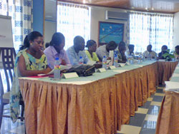
III. Debates in Transitional Justice and Gender
A. Enduring Criticisms of Gendered Bias:
I. Bias in the definition of human rights violations that are prioritized:
The overwhelming focus on killings, disappearances and torture has rendered the human rights record under inclusive and women’s experience of conflict invisible (discrepancy between #s of witnesses giving statements and “victims” suffering violations - politics of primary and secondary victims)
II. Bias in the contexts of human rights violation that are scrutinized:
The principle contexts of women’s victimization have been neglected because of a focus on the exercise of state power and aspirants to state power (South Africa and ‘rape’ as political)
III. Bias in the methodologies of HR investigation that are adopted:
Human rights institutions are alienating and privilege forensic truth and legalistic methodologies that deter women from coming forward, and re-victimize them when they do (ICTY and ICTR proceedings)
IV. Bias in the decision making process
Women are not at the table when mandates are drafted, cases are judged, investigations launched…. (El Salvador, Argentina, Peru)
Notes:
I. protagonists and victims in the international crimes framework carry gendered histories that have foregrounded the male political actor. On the one hand, the iconic ‘perpetrator’ of political violations of bodily injury is the male political actor. From the front line soldier to the head of state to the guerrilla in the jungles, men are the engines of history who have had the power to direct armies and throw Molotov cocktails as office holders in the state or as aspirants to state power. This is the dominant military history, but even more so than that, it is also the ideological construct of the perpetrator that over-determines the transitional justice framework even in contexts where there have been large numbers of female combatants. From jail conditions to decommissioning initiatives, the notion of the male perpetrator has long shaped UN and state policy. Interestingly, from popular culture to human rights policy, the iconic ‘victim’ of international crimes such as disappearances and torture, the dissident targeted by an oppressive regime was, invariably, scripted as male. Females may suffer such injuries as innocent civilians but typically they were not seen to be targeted for their politics, for the views they hold; rather, their injuries are collateral damage – or at least that is the hegemonic narrative of post-war prosecutions that feminists have long sought to undo.
For instance Patricia Sellers notes that women have been invisible in international criminal law: ‘Individuals, unprotected by, or routinely disregarded or marginalized under the Rule of Law, have a tenuous, unsecured membership in their legal community. Under international criminal law, those individuals have traditionally been women.’ See P Viseur-Sellers ‘The Rule of Law Applies to Women’ in United Nations Department of Humanitarian Affairs News, April/May 1997, No 22, available at www.reliefweb.int/OCHA_ol/pub/dhanews/issue22/lawrule.html.
When militant groups have recruited large numbers of women and girls (such as the Shining Path in Peru or the Sri Lankan LTTE in Sri Lanka), those cases are flagged and discussed as extraordinary. The very fact that attention is drawn to their gender underscores the extent to which the male subject of transitional justice is naturalised as the subject.
Thus feminists have pointed out that when women’s injuries were recognized they were marginalised as simply the inevitable casualties of war; for instance, as Sellers notes, in the dominant narrative ‘women are sexually assaulted during wartime because, ‘soldiers will be boys and after a long march …’, to paraphrase Stalin’s Second World War analysis, or because troops must be ‘serviced’ for purposes of morale, as attested to by the plight of the Japanese comfort women. See Sellers, above n 8.
IV. Argentine commission was composed of thirteen commissioners: twelve men and one woman; The TRC was comprised of twelve Peruvian commissioners, ten men and two women

Slide 7
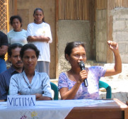
Debates in Transitional Justice and Gender (cont.)
B. Responses to Gendered Bias: Towards Inclusion
I. Problem: Bias in the definition of human rights violations that are prioritized
Response: Redefine the legal definition of international human rights violations such as torture and genocide so that they include sexual violence/rape, change rules of evidence to enable prosecution of crimes like sexual violence, increase sanctions for rape etc. (i.e. “Women are Victims too..” – ex. Ex. Celebici case, Furundzija case etc.)
II. Problem: Bias in the contexts of human rights violation that are scrutinized
Response: Expand one’s understanding of the ‘political’/look at encounters that are not explicitly about political objectives. (i.e. “the personal is political” - ex. Search and seizure operations in Northern Ireland)
II. Problem: Bias in the methodologies of HR investigation that are adopted
Response: Look to testimonials, make space for narrative, value experiential truth
IV. Problem: Bias in the decision making process
Response: Ensure that women are included, conduct gender audits (ICTR: Akeysu)

Slide 8
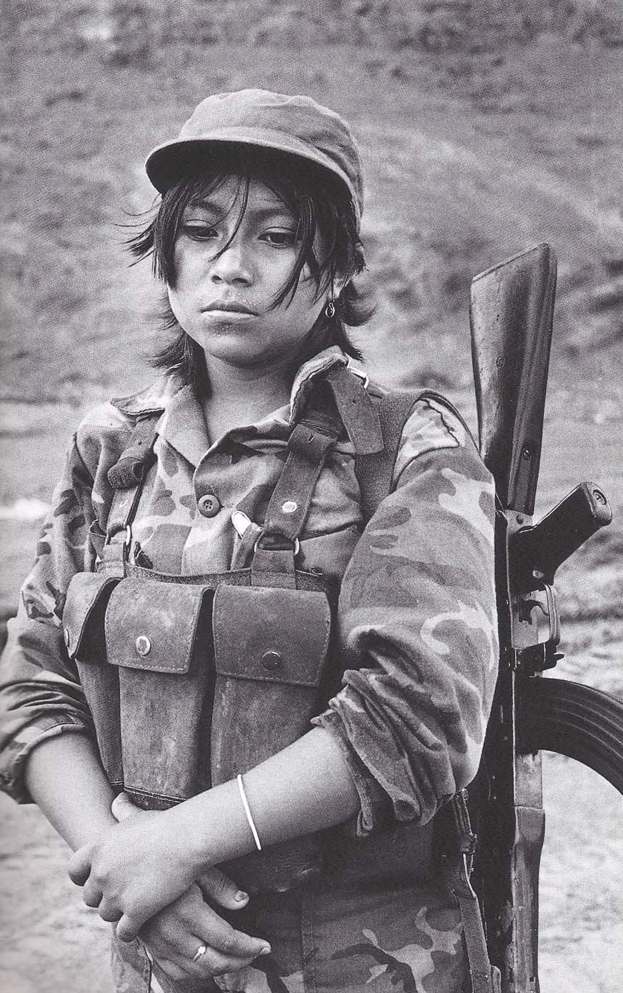
Debates in Transitional Justice and Gender (cont.)
C. Questions re. Responses to Gendered Bias: Limits of Inclusion
I. Problem: Bias in the definition of human rights violations
Response: Redefine torture and genocide so that they include sexual violence/rape, change rules of evidence to enable prosecution of crimes like sexual violence, increase sanctions for rape etc. (i.e. “Women are Victims too..”)
Questions:
  Over victimizes and under-victimizes:
    Over victimization in that it runs the risk of incentivizing victimhood as the way in which women enter the TJ radar (ex. Rosalind Shaw on Sierra Leone);
    Under victimization in that it further entrenches the focus on physical violence rather than structural violence (ex. Sri Lanka; Reparations in the Philippines)
  It also over ‘genders’: it reproduces and polarizes the categories of male and female because it equates women with victimhood while under-counting the ways in which men experience gendered human rights violations (ex. Sexual minorities in Peru), or the ways in which women and men may perpetrate and experience human rights violations in ways that are not captured by gender (ex. Liberia)
Notes:
Undervitimizes:: These crimes have sometimes been referred to as bodily injury crimes because ‘other effects of power’ are ‘stripped away’ and subjectivity condensed ‘to its traces on the body.’ P. 12 of Fiona Ross. While our particular focus in this section of the chapter is prosecutions, Ross demonstrates how the SA TRC’s constituted the victim subject in terms of bodily injury rather than ‘the historical constitution of the subject under apartheid. ‘ (p. 11).
Another Ex: Pinochet: there has been extensive documentation regarding how Pinochet’s regime victimized people not only through his policy of disappearing dissidents but also his economic policy; yet it is only the former who appear as ‘victims’ on the transitional justice radar screen.
over the last decade, the dominant story of the international criminal tribunals addressing war crimes in the former Yugoslavia and Rwanda has been the transformation of women’s subjectivity so that she too can be written as a ‘victim’ of international crimes. If the ‘victim’ or the privileged subject of transitional justice is the one whose rights to bodily integrity are violated, then the raped victim becomes the privileged subject of feminist transitional justice. If the transitional justice field ‘stripped away other effects of power’ and condensed subjectivity ‘to its traces on the body’, then feminist transitional justice stripped away other structural and ideological effects of power to focus on the woman who suffered sexual injury. Bodily integrity injuries such as sexual violence have had to be the privileged frame narratives for women’s subjectivity. This has meant that those injuries had to be pressed into pre-existing legal categories regarding torture or crimes against humanity for inclusion and full representation within transitional justice’s avowed ‘emancipatory’ promise. There is resonance here with the field of sex work, where the privileged subject is the victim of sex trafficking. As Hesford notes, transnational feminist anti-trafficking campaigns are invested in ‘the identification of women as passive and naïve victims lured and tricked into sex work and therefore in need of rescue’. Hesford’s chapter analyses how this representation is mobilised in global advocacy, see W Hesford ???? in W Hesford and W Kozol (eds), Just Advocacy? Women’s Human Rights, Transnational Feminism and the Politics of Representation (New Jersey, Rutgers University Press, 2005), 147.
P. 11-12 of Fiona Ross.

Slide 9
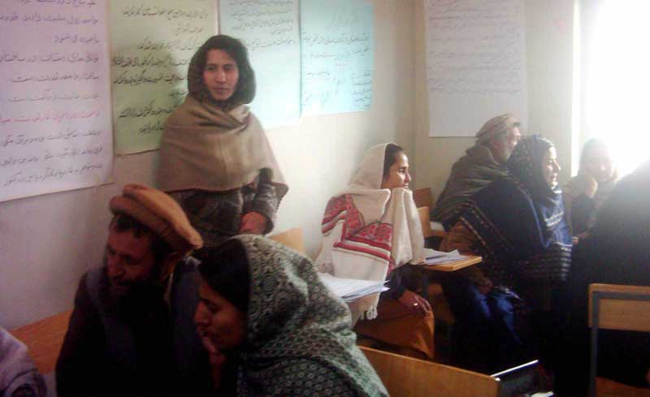
Analytical Account of Transitional Justice and Gender (cont.)
II. Problem: Bias in the contexts of human rights violation
Response: Expand one’s understanding of the ‘political’/look at encounters that are not explicitly about political objectives. (“the personal is political”)
Question: As human rights gets more intrusive it also gets more closely tied with the global politics of intervention (ex. Sierra Leone Forced marriage cases)
III. Problem: Bias in the methodologies of HR investigation
Response: Look to testimonials, make space for narrative, value experiential truth
Question: treats experience as unmediated; truth commission processes themselves frame and produce “truth” (Fiona Ross on Yvonne Khutwane’s story)
IV. Problem: Bias in the decision making process
Response: Ensure that women are included, conduct gender audits
Question: Depoliticizes gender politics (ex. Peruvian commission and question of reproductive rights), underestimates differences amongst women (ex. Nepal), ignores intersectionality in ways that can distort the human rights record (ex. Gujarat reports)
Notes:
III. The feminisation of ‘experience’ rests on an unstated background understanding of women’s voice as a priori an articulation of injury. Thus feminine testimony as already always testimony regarding trauma. The sedimentation of ‘injury’ as the ground from which women enter the transitional justice stage fuels the embrace of the testimonial form and experiential narratives as a project creating ‘safe spaces’ for the ‘traumatised’ voice. As already noted, many oral history projects are founded on the premise that these platforms for testimony provide more authentic access to women’s experience of injury and more space for the recognition and acknowledgement of ‘affect’ as the subversive ‘other’ of law – the feminine that exceeds and spills out of legal categories and judgments.
Note debate on Rigoberto Menchu and contested narratives about the Guatemalan experience of conflict and human rights violations.
IV.Nepal: Sally Merry has described as a culture of ‘transnational modernity’ whose practitioners subscribe to shared norms regarding “the importance of the international domain, universal standards, and procedures for decision making” and a shared lexicon with terms such as “gender mainstreaming” and “capacity building”. P. 31, 48 of Merry

Slide 10
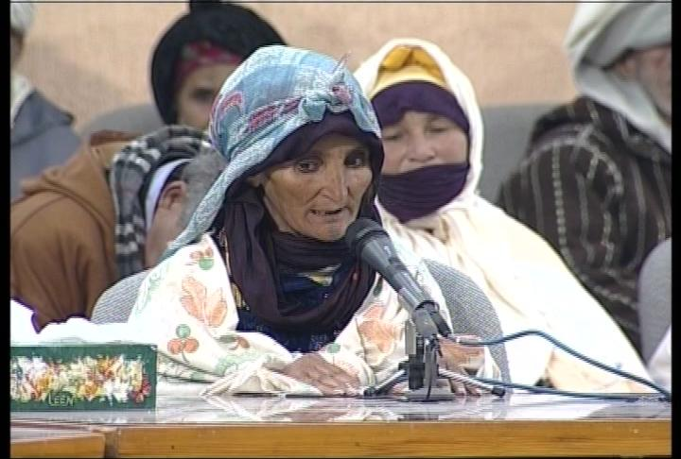
III. Opportunities
A. Truth Commissions: Windows of Opportunity to Address Gendered HR
They can highlight neglected abuses
They can connect the dots in ways that gives us a big picture perspective into the gendered dimensions of human rights history
They can research the enabling conditions of gendered violations
They can provide a forum for victims and survivors - shaping national history from multiple perspectives
They can stage a new approach to gender equality in citizenship – the valuing of all lives, all experiences
They can recommend reparations and justice measures that redress injustices and the work of the truth commission can build political will to that end
They can leave a long-term legacy in transforming moments of transition into moments of social change

Slide 11
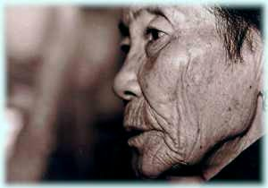
III. Opportunities (cont.)
Ex: Strategies adopted in how truth commissions designed reparations recommendations:
Mandate interpretation with attention to gender
Ongoing consultation with female victims and women’s support and advocacy networks
Recognizing HRVs impose familial care burdens on women; import. of public recognition of the private
Considering background legal rights to title/property ownership in determining restitution
Considering gender power dynamics in controlling financial decision-making in the household
Defining “dependents” in ways that include same-sex partners and customary marriages •
Taking steps to ensure that reparations also address the long-term impact of conflict, addressing the continuities between human rights abuses in times of peace and war
Consideration for reparation programs to incorporate need-based criteria in establishing the reparations programs (ex. Enabling programs with reach to women victimized by the conflict, even if not technically qualified as victim; this may include measures that recognize the systemic, collective patterns of abuse against women)
Making provisions for open lists to allow victims who did not go to the commission to have more time to submit statements and qualify as beneficiaries
Notes:
Gender-differentiated income patterns (including unpaid housework) have also had an adverse impact on women in cases where reparations have been pegged to lost income. For example, some proposals for reparations for victims of martial law in the Philippines calculate lost earnings in determining reparation payments; this will distort reparation payments in ways that are unfair to women and other low-income groups. The use of the average civil servant’s salary in Chile has provided a much more equitable approach. It has also underscores the principle that redress is proportionate to the crime rather than the individual’s pecuniary loss—a particularly important measure when there are entrenched gender disparities in real wages. In a proactive effort to address any gender inequities that may arise in the formulation and implementation of reparations policies, the Timorese CAVR recommended that at least 50 percent of all reparations should go to women; this recognizes that women were underrepresented in the statement-taking process and partly compensates for the distortions that may result in defining beneficiaries.

Slide 12

III. Opportunities (Cont)
C. Critically Reflective Gender Analysis:
Window of Opportunity for Truth Commissions
Gender-focused work can provide a critical space within commissions to open up the transitional justice paradigm and contest myths about cure-all transitional justice mechanisms
Interrogate the complexities of “victim” identity – more nuanced discussion of the politics of agency
Challenge the exclusive focus on bodily injury crimes and individual victims to have a more complex engagement with the technologies of power
Push truth commissions to go beyond individual perpetrators to develop a more nuanced understanding of wider accountability (“willing executioners”) and the enabling conditions of systemic injustices
Go beyond civil and political rights violations to address the background economic and social structures
Challenge official histories and assumptions about linear progress
Expose the hierarchies embedded within the human rights field
Draw attention to the continuities and discontinuities between ordinary and extraordinary violence, periods of conflict and periods of “post conflict
Open the door to addressing root causes of conflict
Notes:
Going beyond bodily injury crimes

