Slide 1

RECOM Process

Slide 2
September 2005:
Discussion of 10 leading human rights organizations from the post-yugoslav countries on mechanisms to identify the facts about the recent past and their public disclosure.
The Humanitarian Law Center, based in Serbia, the Research and Documentation Centre (IDC), based in Bosnia and Herzegovina, and Documenta, based in Croatia made a commitment to initiate debate among civil society organizations in the region about the past and ways to uncover the truth which would focus on the victims, and which might, in addition to criminal trials, contribute to a more complete factual record of past events.

Slide 3
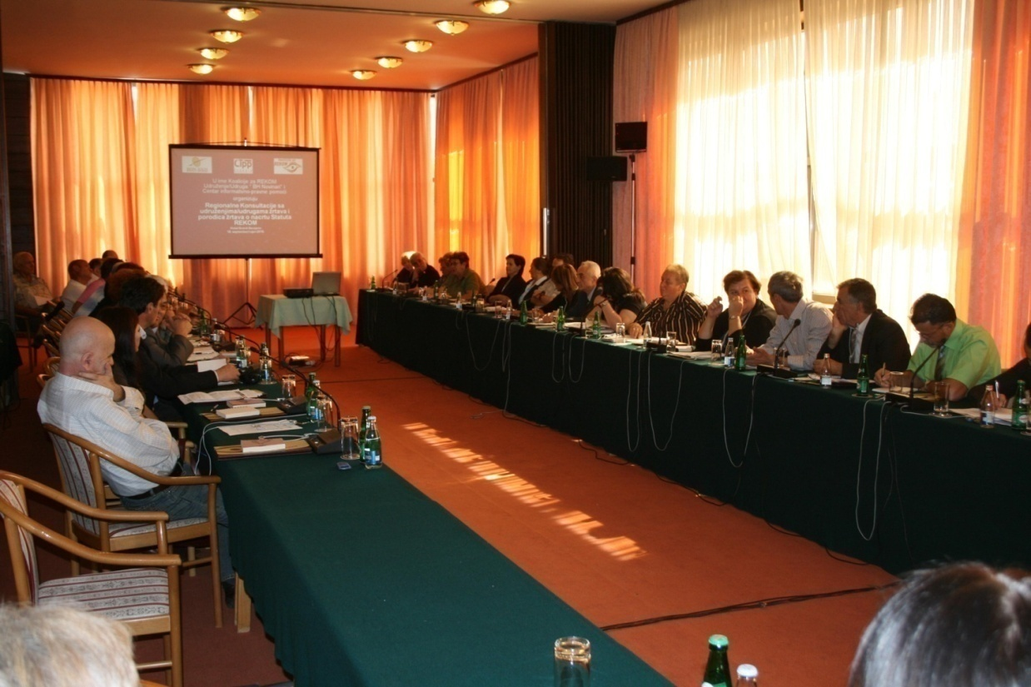
I Consultation process

Slide 4
Consultations and Coalition
By the end of June 2011, 127 consultations had been held, along with seven regional and one international forum for Transitional Justice.
The consultations were attended by 6,187 activists from human rights organizations, youth organizations, associations of victims families, former war prisoners, veterans/soldiers, artists, teachers, representatives of religious communities, and other groups and associations of civil society from all successor states of the former Yugoslavia.
By the end of July of 2011, the number of Coalition members rose to 1,818: 342 non-governmental organizations, 64 associations of victims and victims’ family members, 12 veterans’ organizations, 25 media outlets, 8 religious organizations, 10 political organizations (such as political parties, branches and committees of political parties, local government organizations) and 1,357 individuals from among the victims, religious communities, artists, writers, directors and others.
Assembly of the Coalition for RECOM composed of individuals delegated jointly by coalition members.
The Coordinating Council of the Coalition for RECOM is mandated to monitor the implementation of decisions of the Assembly.
The Secretariat of the Coalition for RECOM is a professional body, which has associates who receive compensation for their work in accordance with the project led by the Humanitarian Law Center.

Slide 5
Phase I
May 2006 to May 2008 (the first phase), were devoted to assessing the needs and expectations of victims and families of victims, in the context of the difficult legacy of the past, as well as discussing the extra-judicial mechanisms for establishing the facts about war crimes.
On May 8, 2008, at the consultation meetings with victims' families, camp detainees and war prisoners from Croatia, Bosnia and Herzegovina, Serbia, Montenegro and Kosovo, the HLC, IDC and Documenta proposed an initiative for the establishment of the Regional Commission for identification and public disclosure of the facts about war crimes. Natasa Kandic proposed that the regional commission be abbreviated as RECOM.

Slide 6
Phase II
In the second phase the participants came forward with suggestions, opinions and recommendations about the RECOM, taking into account the experience of other post-conflict and post-totalitarian societies.
All agreed that the most urgent task was to secure evidence of the names of war crimes victims, dead and missing.
All were in agreement that RECOM should be tasked with creating a complete list of all former detainees and places of detention.
The participants agreed that RECOM would be capable of contributing to the resolution of the fate of the missing persons and of discovering mass graves.
Some family members of missing persons suggested that RECOM propose to the courts an amnesty for those perpetrators who agree to disclose the location of mass graves. Most participants supported the suggestion, but some were vocally against it.
A number of participants argued that RECOM should have the right to summon former government officials, media representatives, institutions and religious communities to speak about the role and operation of their institutions or former institutions.

Slide 7
Phase III
Starting in May 2010, the participants discussed objectives and functions of RECOM.
To acknowledge injustices inflicted upon victims in order to help create a culture of compassion and solidarity with victims.
To contribute to the fulfilment of victims’ rights.
To help political elites and society to accept the facts about war crimes and other gross violations of human rights.
To help clarify the fate of the missing persons, and,
To help prevent the recurrence of war crimes and other gross violations of human rights.
Compiling registers of human losses related to wars or other forms of armed conflict, to include:
i. Civilians whose loss of life or disappearance.
ii. Combatants whose loss of life or disappearance was caused by the war or other form of armed conflict.
Researching the political and societal circumstances that decisively contributed to the outbreak of wars or other forms of armed conflict as well as to the commission of war crimes and other gross violations of human rights.
Holding public hearings of victims and other persons about war crimes and gross violations of human rights.
March 26, 2011: The Assembly of Coalition for RECOM adopted the Draft Statute of RECOM.

Slide 8
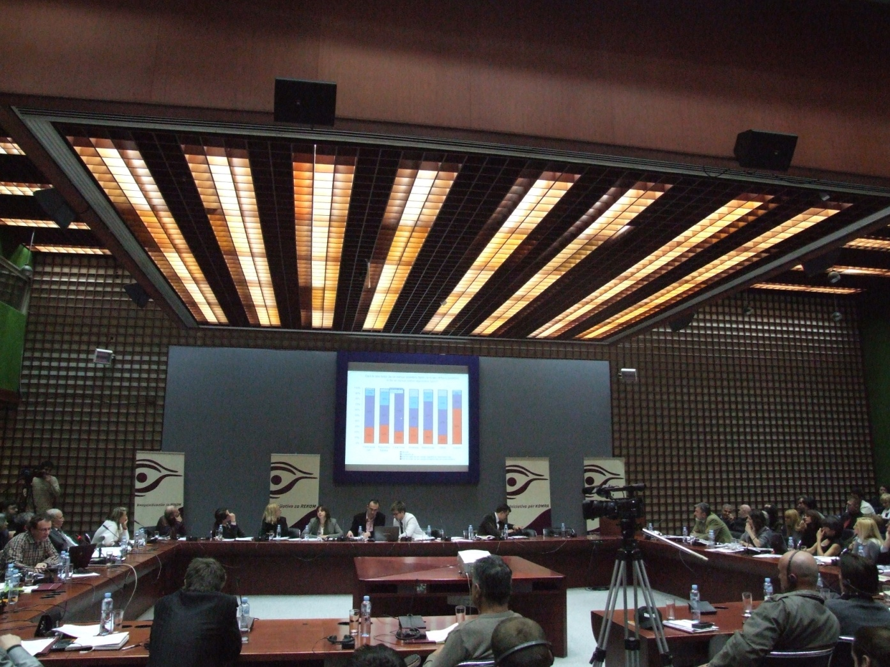
II The Media Campaign

Slide 9
Media campaign
Phase One entitled For RECOM was launched on June 1, 2010 in all post-yugoslav countries, with the slogan: “The Facts about all Victims of 1991-2001 Wars in the former Yugoslavia.”
A TV clip, Why RECOM? was broadcast during the campaign, with participants speaking in their native languages.
Nine newspaper ads have been published. Eight regional newspapers carried 90,000 supplements each, entitled We Need to Know: For Me, For Him, For Us, with three different photographs and slogans. A total of 540,000 copies were placed in the press.
In March 2010, the campaign launched a web page www.zarekom.org. On-line membership sign-up for RECOM has been active as of June 2010.
As of July 15, 2010, the Initiative for RECOM had a presence on Facebook and Twitter.
Between November 1, 2010 and April 26, 2011, the Initiative for RECOM was the main topic of 11 TV programs and one radio show.

Slide 10
The Media Campaign in Support of the One Million Signatures Campaign
Between April 26 and July 30, 2011, a media campaign was launched with the slogan RECOM: Sign It!
Five video clips created for the media campaign. The video clips were shown on TV channels in all of the countries of the former Yugoslavia, in total, 1,056 times, after the signature support campaign was launched on April 26, 2011.

Slide 11
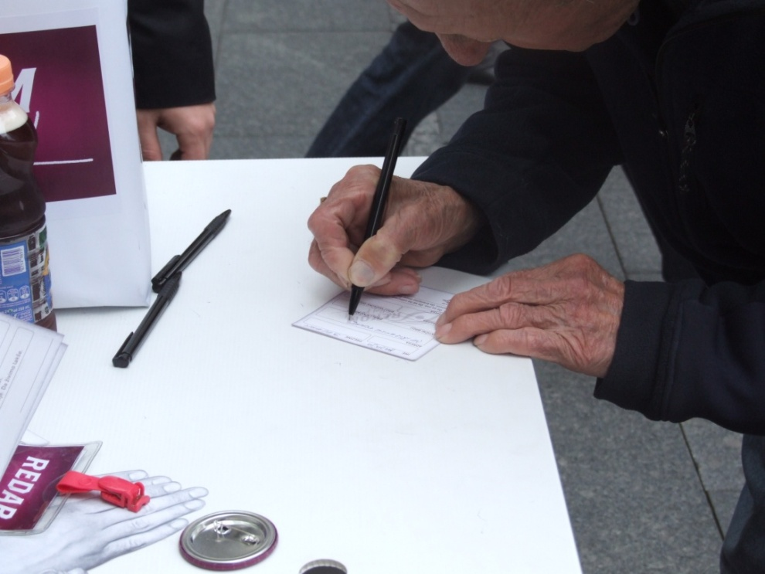
III The Campaign One Million Signatures for RECOM

Slide 12
The Campaign One Million Signatures for RECOM was launched on April 26, 2011 with a street action titled Regional Defrosting, which was held simultaneously in Belgrade, Ljubljana, Zagreb, Sarajevo, Banja Luka, Prishtina/Prishtinë, and Skopje. The campaign ended on June 30, 2011, and in the nine weeks of its duration collected 543,870 signatures supporting the establishment of RECOM. In Bosnia and Herzegovina, 122,540 signatures were collected, in Croatia, 19,674, in Montenegro, 31,060, in Serbia, 254,625, in Kosovo 100,566, in Slovenia 5,3456 and in Macedonia, 10,059.
The campaign was regionally coordinated by the Youth Initiative for Human Rights in Croatia and the Youth Initiative for Human Rights in Serbia, with local partners in all countries of the former Yugoslavia.
The campaign involved 1,301 volunteers. They collected signatures at 219 sites in the capitals and major towns in the countries of the former Yugoslavia. Door-to-door action was also part of the campaign.
The main surprises in the campaign came in Banja Luka where an unexpectedly high number of signatures was collected (46,000) and in Kosovo (100,559), despite the lack of political and media support, and despite continuous calls for a boycott by the management of the leading associations of victims and veterans. Little popular support in Croatia for the Initiative for RECOM is partly the consequence of widespread resistance to regional cooperation, which was further enhanced by the convictions of generals Ante Gotovina and Mladen Markac, whom the ICTY sentenced to prison terms on April 15, 2011.

Slide 13
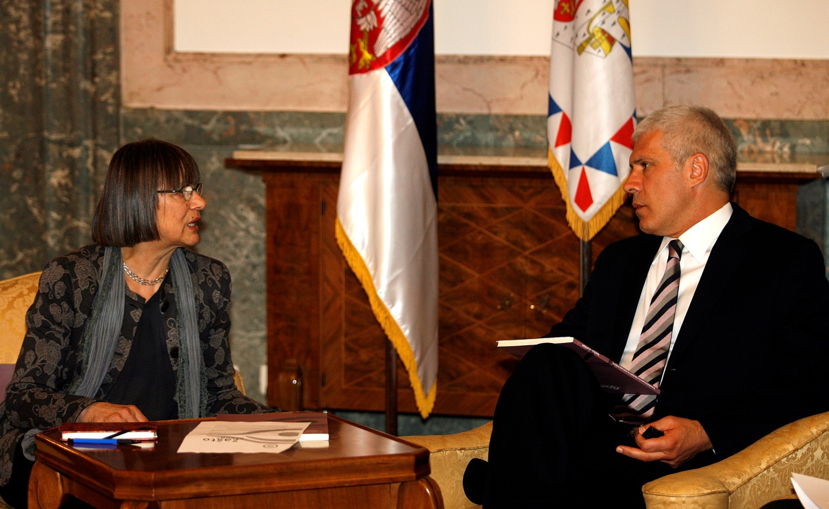
IV Public Advocacy Campaign for the Establishment of RECOM

Slide 14
Regional Support
The initiative to create the Commission received open support from the highest representatives of the government and from the political elite in all post-Yugoslav countries.
Artists and Intellectuals Seeking the Establishment of RECOM
The Letter of Support to the Initiative for RECOM, sent on October 7, 2011, and addressed to the presidents and members of the presidency of the countries of the former Yugoslavia, was signed by 155 regionally renowned intellectuals and artists.
We, for whom the war in the former Yugoslavia, with all its consequences, has become the subject of professional research and artistic vision, an occasion for reflection and concern about the fate of memory and truth, ask you to do everything in your power to enable the Initiative for RECOM to come to life and to begin its operation, wrote the artists and intellectuals in their letter.

Slide 15
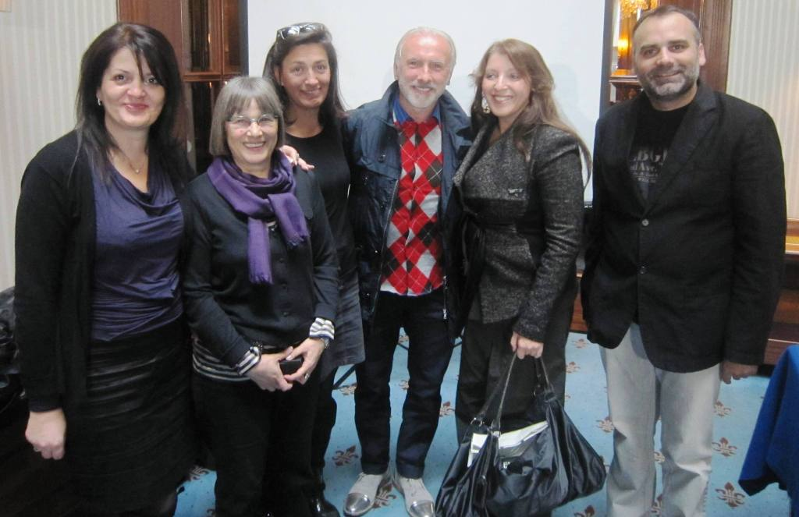
Artist support
(sarajevo, October 8.)

Slide 16
At a press conference held in Sarajevo (BiH) on this occasion on October 8, 2011, Dino Mustafic, director from Bosnia and Herzegovina, Mirjana Karanovic, actress from Serbia, Ursa Raukar, actress from Croatia, and Dino Merlin, musician from Bosnia and Herzegovina spoke in support of the Initiative for RECOM.
"This is a broad initiative of the citizens who want to institutionalize the truth through the system," said Dino Mustafic and added: "We all know to what extent the victims are being manipulated and we know very well that this can only lead to new clashes."
Ursa Raukar supports the establishment of RECOM because the commission has the potential to prevent manipulation: "Horrible crimes were committed, but another major crime is the manipulation of victims."
Mirjana Karanovic fears the return to the Serbian political scene of the rhetoric from the 1990s: "I am still angry with the way the national television of Serbia manipulated the dead."
Musician Dino Merlin believes that the commission could stop the relativization of crimes: "He who denies Srebrenica, is doing the same with regard to Jasenovac."
Slovenian director Dusan Jovanovic believes that the Initiative is well planned, and hopes the appeal for its establishment will bear fruit. From politicians he expects much more than a principled support.

Slide 17
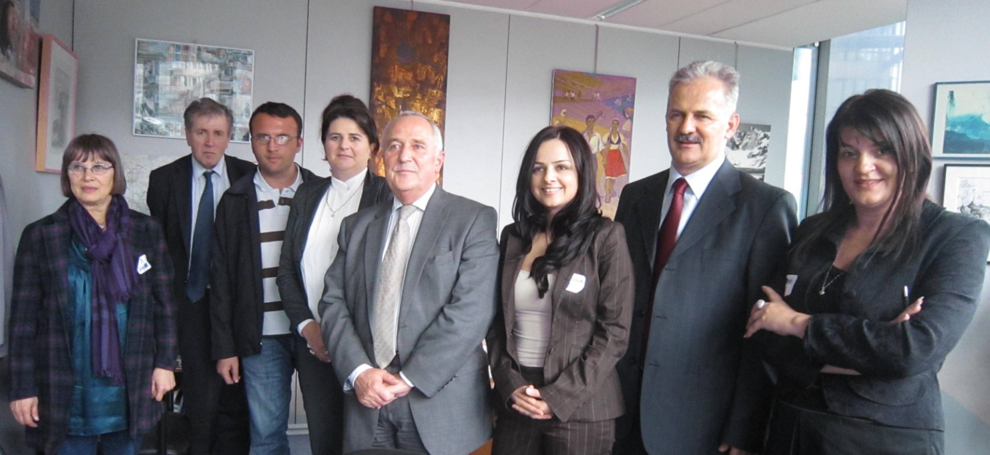
International Support

Slide 18
At a meeting on September 30, 2009, President of the European Parliament’s Human Rights Sub-committee, Heidi Hautula, assessed that “this is the first time such an important initiative has come to us from there.”
The support of the European Parliament was expressed at the Fourth the Inter-Parliamentary meeting of the Serbian National Assembly and the European Parliament, held
On October 5, 2010 in Belgrade, the Chairman of the Committee for European Integration of the Serbian Parliament, Laszlo Varga, and the Chairman of the European Parliament's Delegation to Albania, Bosnia and Herzegovina, Serbia, Montenegro and Kosovo, Eduard Kukan, expressed their support for the Initiative for RECOM.
A Resolution of the European Parliament adopted on January 19, 2011 supports the RECOM Initiative characterizing it as a process designed to raise awareness and enhance the process of reconciliation across the Western Balkans. The Resolution urges the authorities of Serbia and other countries in the region to support the initiative.
On January 26, 2011, the Parliamentary Assembly of the Council of Europe adopted the report by Mr. Pietro Marcenaro, Rapporteur of the Foreign Affairs Committee, who urged “all countries in the region of the former Yugoslavia to participate in the establishment of RECOM, regardless of their status, in order for the Commission to fully achieve its goal of reconciliation and recognition of all victims.”

Slide 19
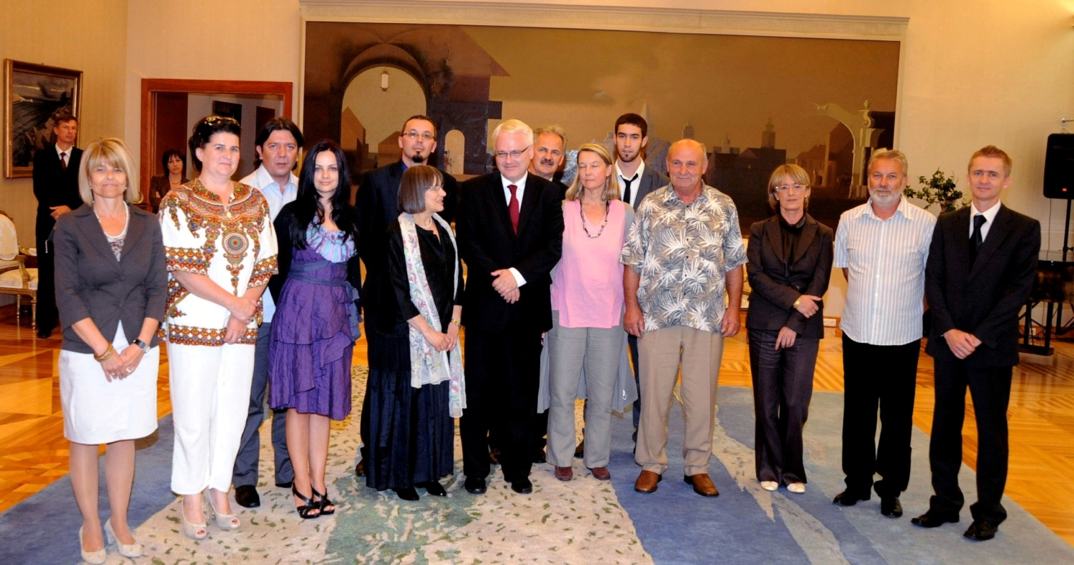
V Institutionalization of the RECOM Development Process

Slide 20
The Initiative for RECOM was first institutionalized in Montenegro. In June 2011, the Government of Montenegro formed a working group to consider the Initiative for RECOM. In June 2011, the Coalition for RECOM submitted to the President of Croatia Ivo Josipovic and member of the Presidency of Bosnia and Herzegovina Zeljko Komsic a Petition for the establishment of RECOM, along with RECOM’s Draft Statute. They both expressed strong personal support, committing themselves to promoting the Initiative for the establishment of RECOM within regional activities in their respective countries.
The Coalition for RECOM is yet to meet with the presidents of other countries in the region, and win the support of the relevant institutions to initiate the procedure for signing an international or a political agreement to establish the Commission.

Slide 21


Thank you!

